Slide 1

Explore Relational Data in Azure
Week 6 - Lab 3 Preparation & Guidelines
Dr Farshid Keivanian

Slide 2
Week 6 – Lab 3
This PowerPoint is an optional guide to help you implement the steps from the official Week 6 – Lab 3 document. You must still follow the exact instruction and requirements as outlined in the official Canvas instructions and rubric.

Slide 3
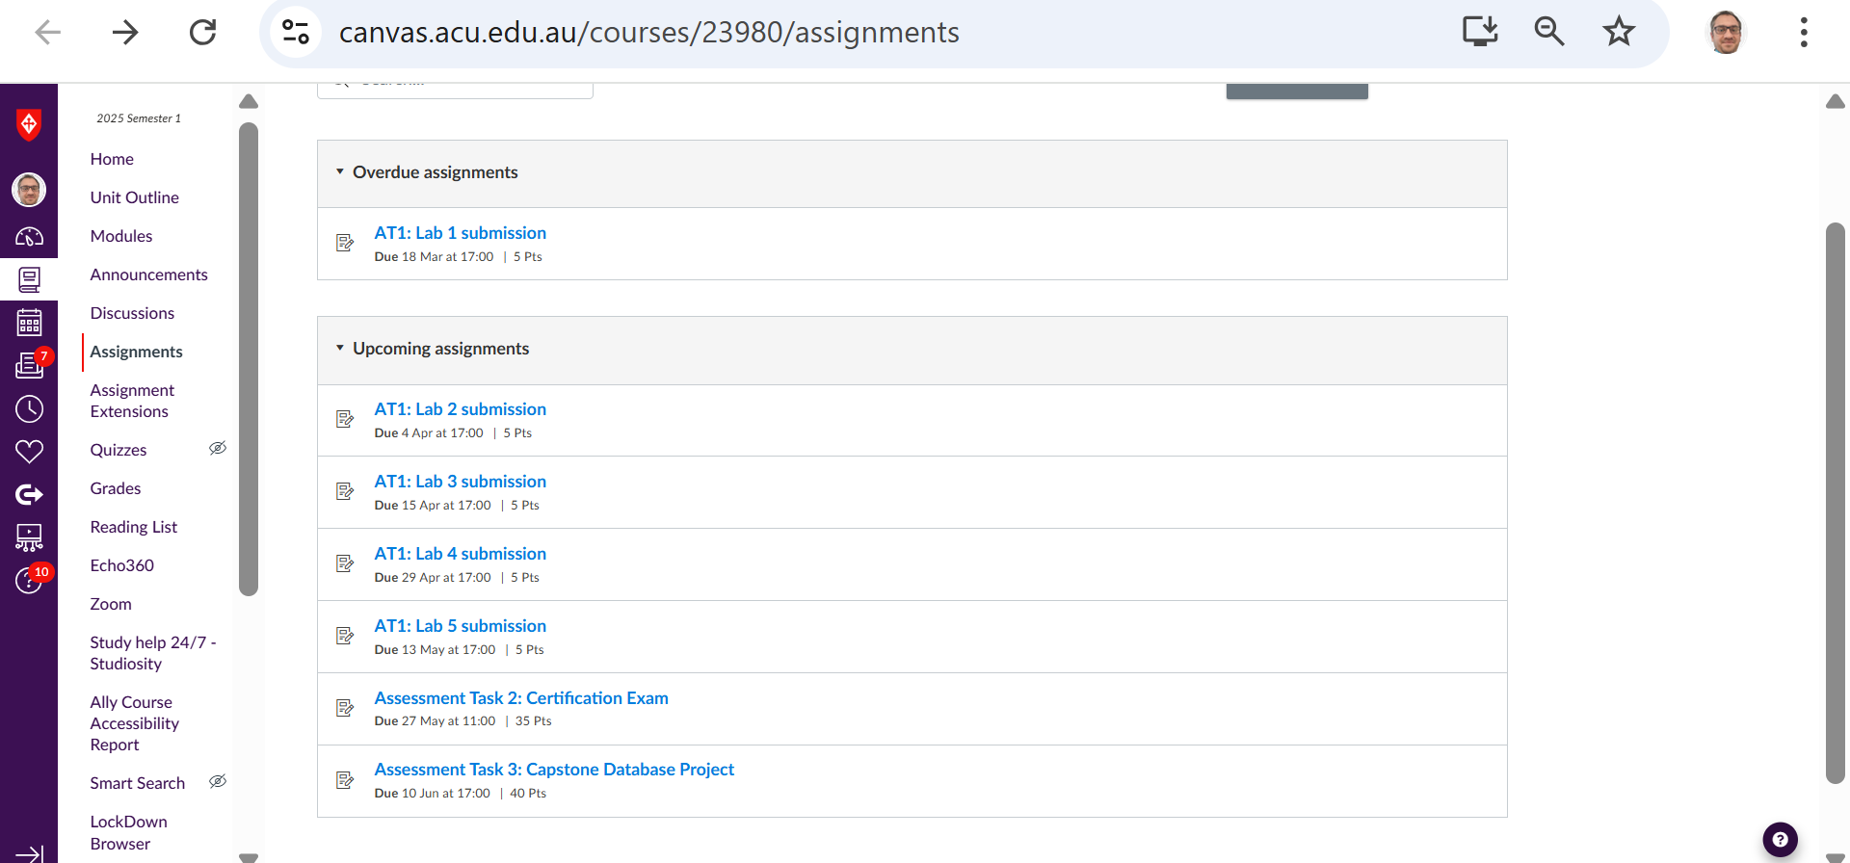
Week 6 – Lab 3
Navigate Canvas >> Modules >> Week 6: Lab 3
2 | Faculty of Business and Law | Peter Faber Business School

Slide 4
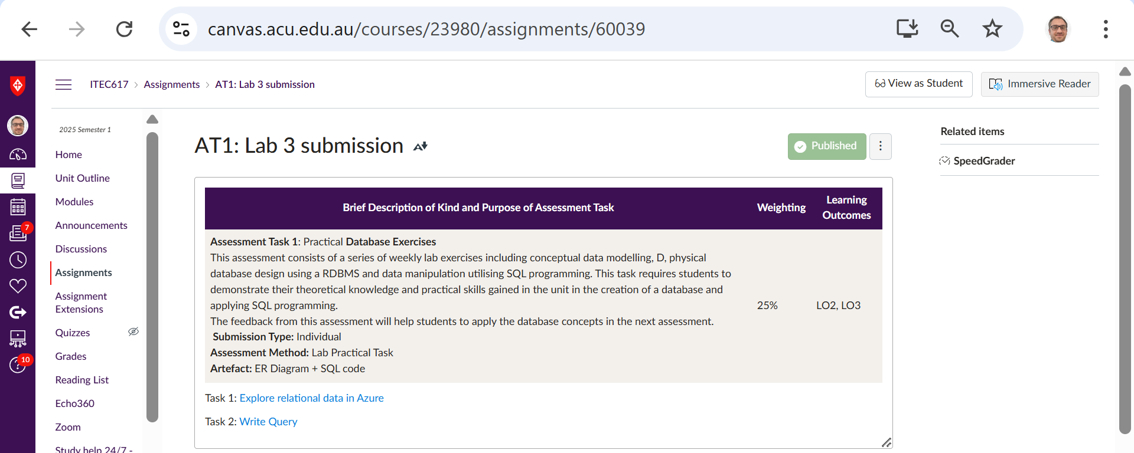
Week 6 – Lab 3
Navigate Canvas >> Modules >> Week 6: Lab 3
2 | Faculty of Business and Law | Peter Faber Business School

Slide 5
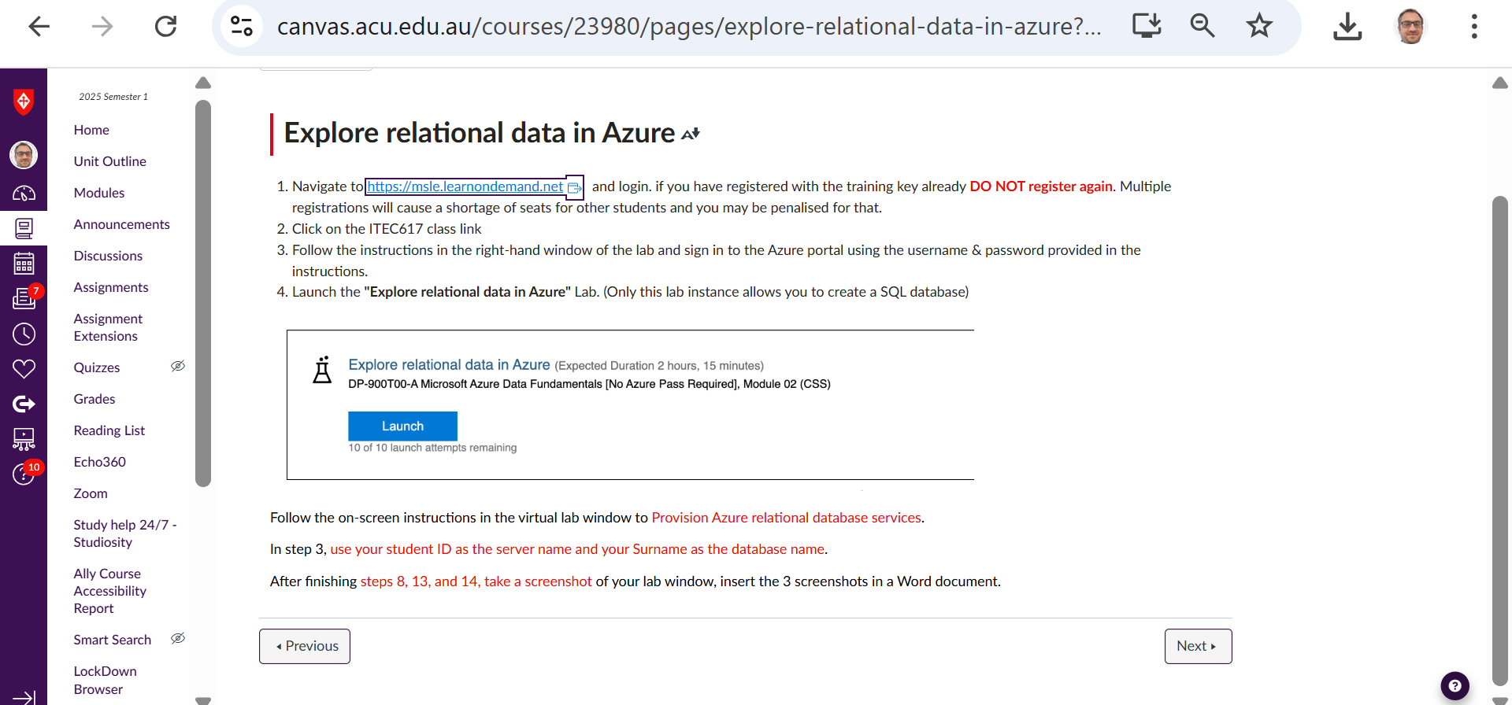
Week 6 – Lab 3
Navigate Canvas >> Modules >> Week 6: Lab 3
https://msle.learnondemand.net/User/Login?ReturnUrl=%2F
2 | Faculty of Business and Law | Peter Faber Business School

Slide 6
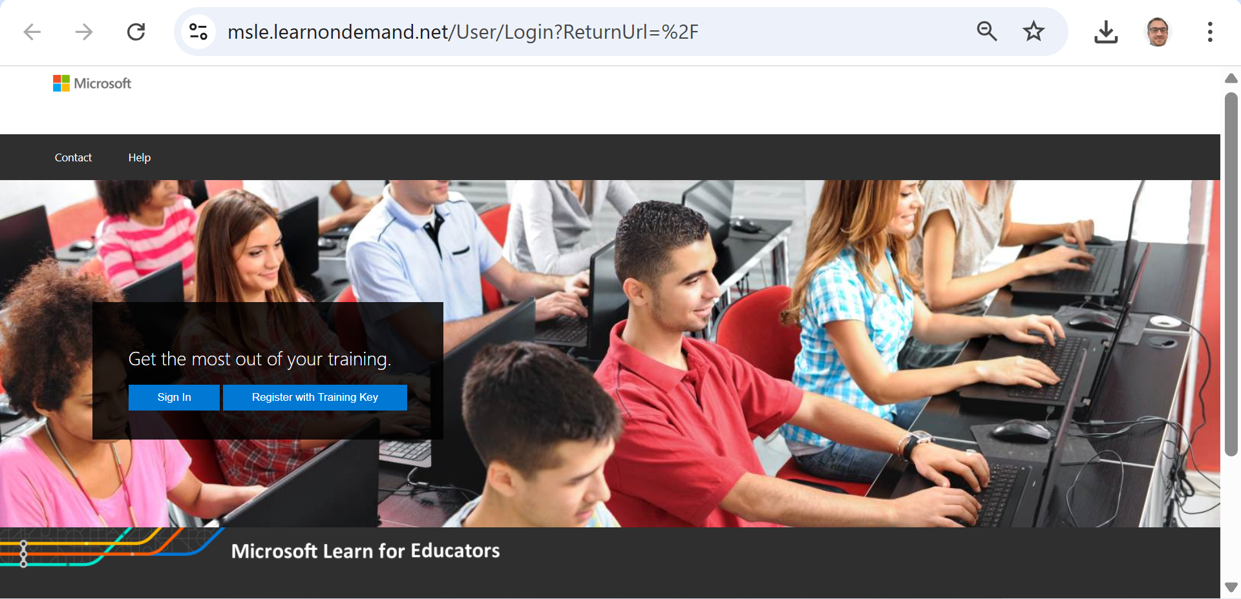
Week 6 – Lab 3
2 | Faculty of Business and Law | Peter Faber Business School

Slide 7
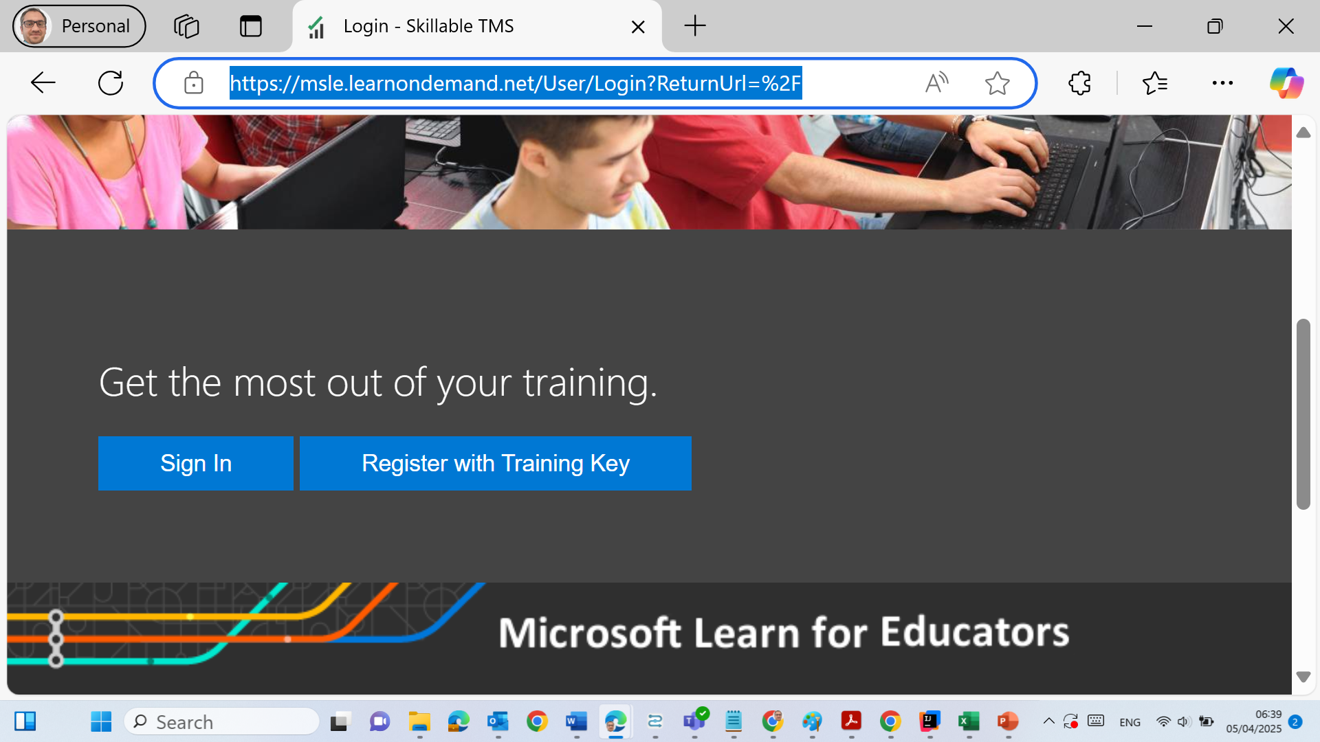
Week 6 – Lab 3
Click on "Register with Training Key", in the popup window, and enter the following training key: Training Key: 2F5F0B5091B345FF
2 | Faculty of Business and Law | Peter Faber Business School

Slide 8
Situation | Action
You've already used the training key | Click Sign In
This is your first time | Click Register with Training Key and enter the key once
You don't know the key | Check Canvas or ask your lecturer
2 | Faculty of Business and Law | Peter Faber Business School

Slide 9
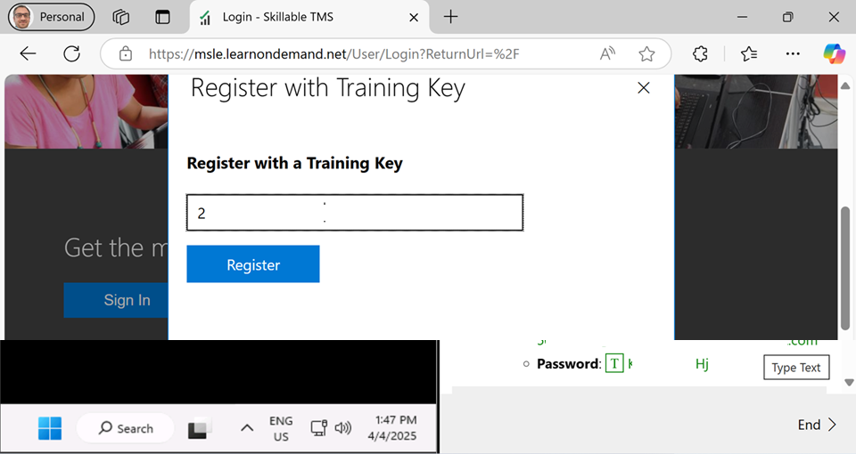
Week 6 – Lab 3
Click on "Register with Training Key", in the popup window, and enter the following training key: Training Key: Please refer to Canvas >> Modules >> Week 4 >> Access to Microsoft Virtual Lab
2 | Faculty of Business and Law | Peter Faber Business School

Slide 10
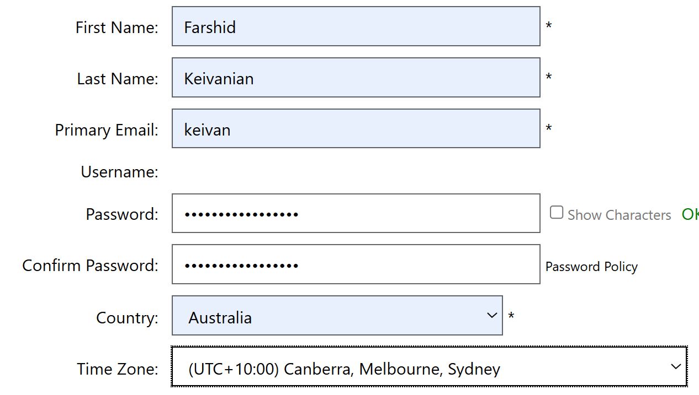
Week 6 – Lab 3
Provide the required details (Name, email, ...) and complete your registration.
Use your personal email address for registration (not your ACU email).
Save
2 | Faculty of Business and Law | Peter Faber Business School

Slide 11
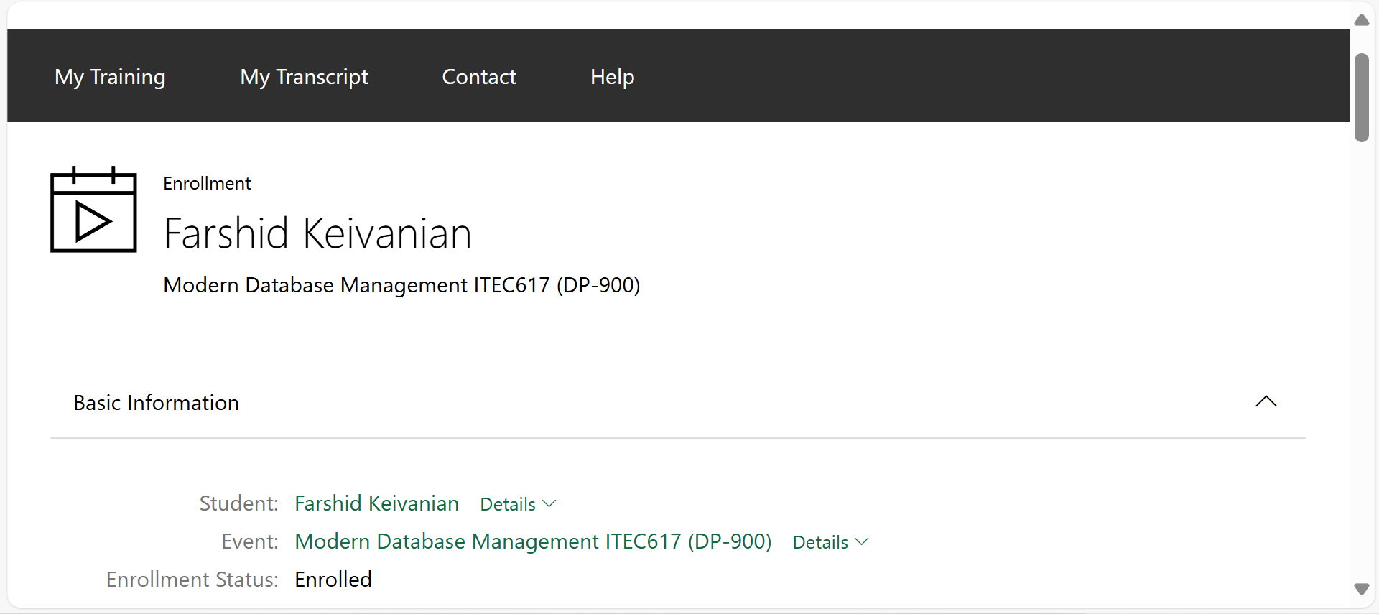
Week 6 – Lab 3
You will see this
2 | Faculty of Business and Law | Peter Faber Business School

Slide 12
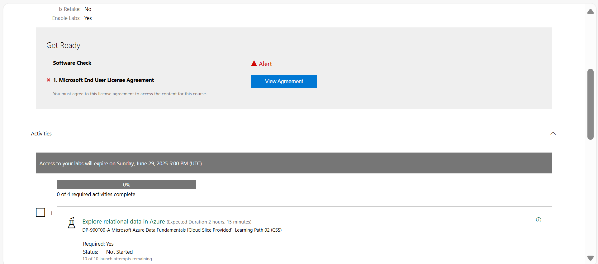
Week 6 – Lab 3
View Agreement
2 | Faculty of Business and Law | Peter Faber Business School

Slide 13
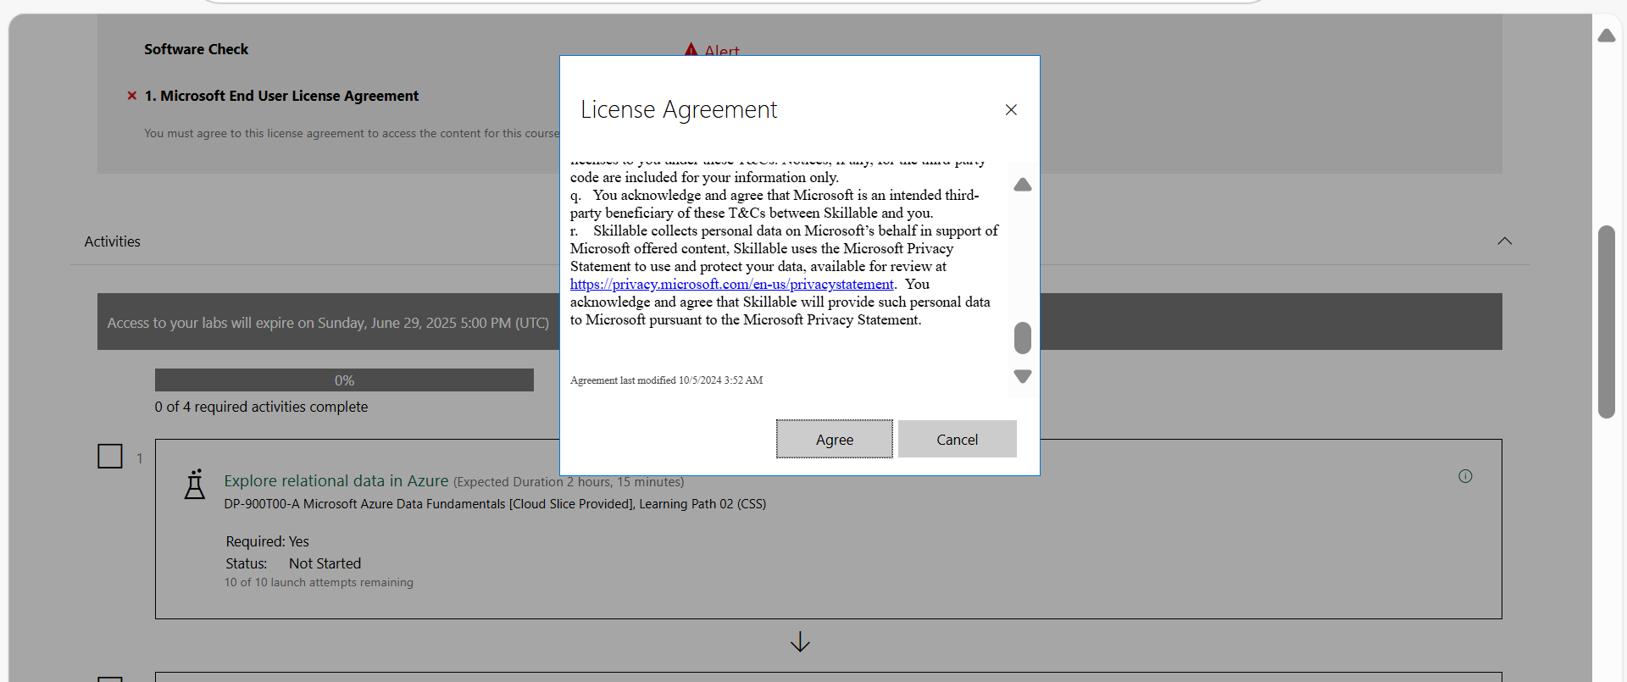
Week 6 – Lab 3
Agree
2 | Faculty of Business and Law | Peter Faber Business School

Slide 14
Week 6 – Lab 3
Courses that use our Cloud Slice technology do NOT have saves enable. These courses have labs that are broken down into smaller sizes and are designed to be completed in one sitting. Please note that Cloud Slice labs can only be launched a total of 10 times.
2 | Faculty of Business and Law | Peter Faber Business School

Slide 15
Week 6 – Lab 3
Type of Lab | Save Allowed? | Notes
Cloud Slice Labs | X No | Finish in one sitting, 10 launches max
Normal Labs | Yes | Save for 7 days, then auto-deletes
2 | Faculty of Business and Law | Peter Faber Business School

Slide 16
Is this course using Cloud Slice labs or Normal Labs?
Week 6 – Lab 3
According to the unit outline:
The course ITEC617 – Modern Database Management is aligned with the Microsoft DP-900 Azure Data Fundamentals certification.
It uses Skillable labs, specifically the Microsoft Learn On Demand platform (msle.learnondemand.net).
Based on the details and structure, the course uses both types of labs:
2 | Faculty of Business and Law | Peter Faber Business School

Slide 17
Week 6 – Lab 3
Breakdown of Lab Types:
Lab Session | Topic | Lab Type | Saving Enabled? | Notes
Lab 1 & 2 | Setup + SQL Basics | Normal Lab (Skillable) | Yes | SQL practice, MySQL setup
Lab 3 | Explore relational data in Azure | Cloud Slice | X No | Must be done in one sitting (up to 10 launches)
2 | Faculty of Business and Law | Peter Faber Business School

Slide 18
Week 6 – Lab 3
Breakdown of Lab Types:
Lab Session | Topic | Lab Type | Saving Enabled? | Notes
Lab 4 | Data Definition with SQL (MySQL) | Normal Lab | Yes | On your own PC using MySQL Workbench
Lab 5 | Explore non-relational data in Azure | Cloud Slice | X No | Azure virtual lab – 10 launches only
2 | Faculty of Business and Law | Peter Faber Business School

Slide 19
Week 6 – Lab 3
Breakdown of Lab Types:
Lab Session | Topic | Lab Type | Saving Enabled? | Notes
Lab 6 | DP-900 Practice Test | Cloud Slice | X No | Practice exam must be done in one sitting
2 | Faculty of Business and Law | Peter Faber Business School

Slide 20
Lab Goals
This lab aims to help students:
Understand the fundamentals of relational databases in the Azure cloud.
Learn how to provision and explore relational database services using Microsoft Azure.
Gain hands-on experience using the Azure portal to create and manage SQL databases.
Recognize how cloud services differ from traditional on-premises database solutions.
2 | Faculty of Business and Law | Peter Faber Business School

Slide 21
Theoretical Background
Relational databases use tables to store structured data, and they rely on SQL (Structured Query Language) for querying and manipulation. In cloud platforms like Azure, services such as Azure SQL Database offer:
High availability
Scalability
Security
Built-in management features (e.g., automated backups)
2 | Faculty of Business and Law | Peter Faber Business School

Slide 22
Azure abstracts infrastructure details, enabling developers and analysts to focus on database logic and performance without maintaining physical servers.
2 | Faculty of Business and Law | Peter Faber Business School

Slide 23
Skills Developed
By completing this lab, students will be able to:
Navigate Azure Lab environments and the Azure portal
Provision an Azure SQL Database
Use SQL Server credentials and configurations
Apply best practices for secure and efficient cloud-based database management
Understand cloud-based relational database architecture and services
2 | Faculty of Business and Law | Peter Faber Business School

Slide 24
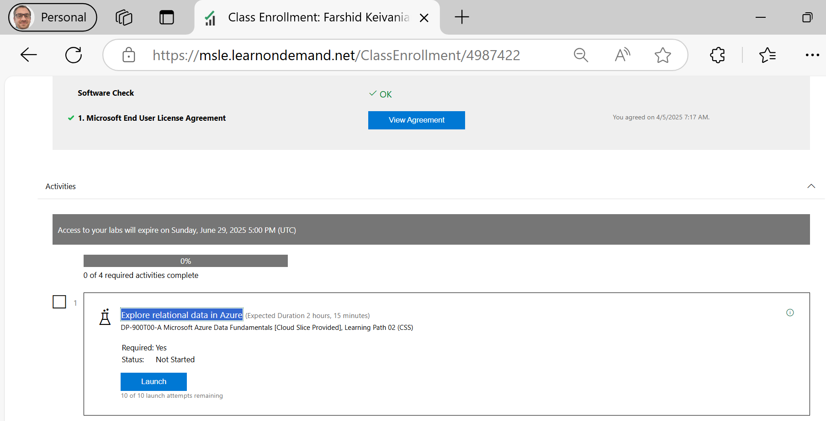
We’ll be taken to a screen listing lab modules for DP-900
Click Launch on “Explore relational data in Azure”
Lab Duration: ~2 hours 15 minutes You have 10 attempts available
2 | Faculty of Business and Law | Peter Faber Business School

Slide 25
Should students complete the lab during the lab session or later?
➤ These labs can usually be paused and resumed later (as long as they don’t close the browser or exceed the time limit). However, it’s best to complete it within the session, especially if there’s a limited number of launches (e.g., 10 attempts).
2 | Faculty of Business and Law | Peter Faber Business School

Slide 26
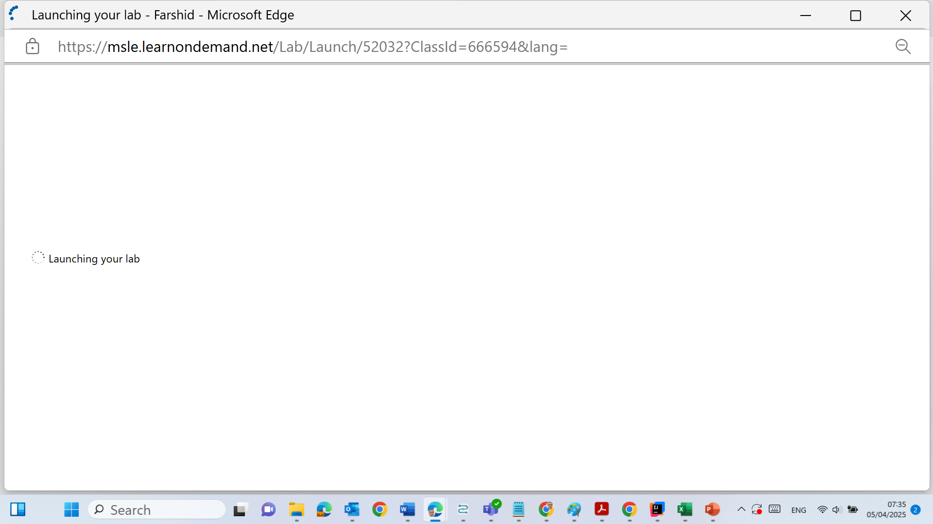
Launch the "Explore relational data in Azure" Lab. (Only this lab instance allows you to create a SQL database)
2 | Faculty of Business and Law | Peter Faber Business School

Slide 27
Use the temporary credentials provided on the right-hand side of the lab window
Once inside the Azure Portal, begin following the instructions provided in the virtual machine pane
In Step 3 of the lab instructions, use:
Your student ID as the server name
Your surname as the database name
2 | Faculty of Business and Law | Peter Faber Business School

Slide 28
Follow the on-screen instructions in the virtual lab window to Provision Azure relational database services.
In step 3, use your student ID as the server name and your Surname as the database name.
2 | Faculty of Business and Law | Peter Faber Business School

Slide 29
Documentation
On the right-side menu, it will be showing step number.
When you complete:
Step 8
Step 13
Step 14
Take a screenshot of each
Insert them into a Word document
Submit as instructed via Canvas
2 | Faculty of Business and Law | Peter Faber Business School

Slide 30
What to Avoid
Do NOT register with the training key more than once
Do NOT close your browser during lab execution – it will reset your session
Do NOT skip firewall configuration – otherwise, you won’t be able to query the DB
2 | Faculty of Business and Law | Peter Faber Business School

Slide 31
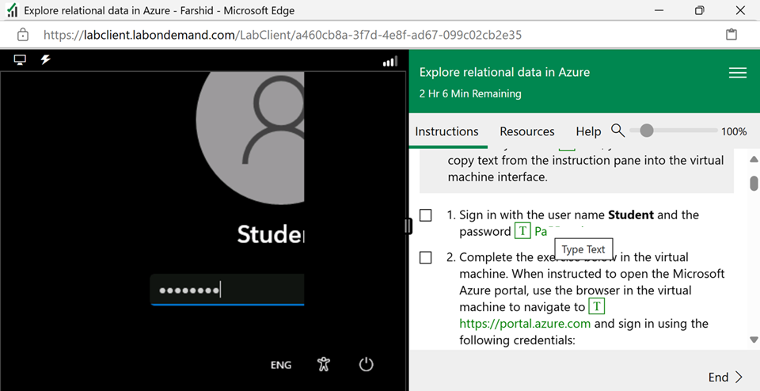
Click on T to type the password by machine
Press Enter
2 | Faculty of Business and Law | Peter Faber Business School

Slide 32
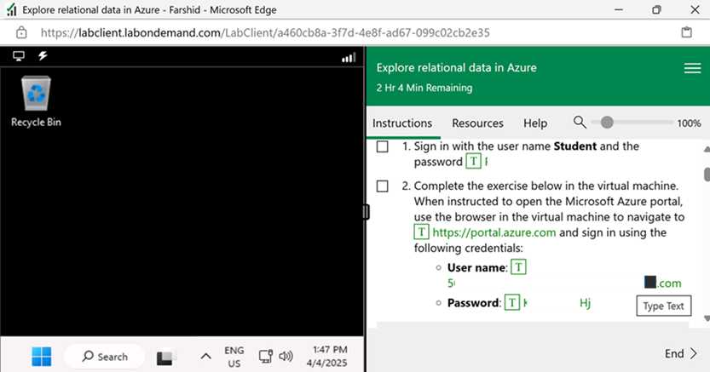
You will see this
When instructed to open Microsoft Azure portal:
Use the browser in the virtual machine to navigate to https://portal.azure.com
2 | Faculty of Business and Law | Peter Faber Business School

Slide 33
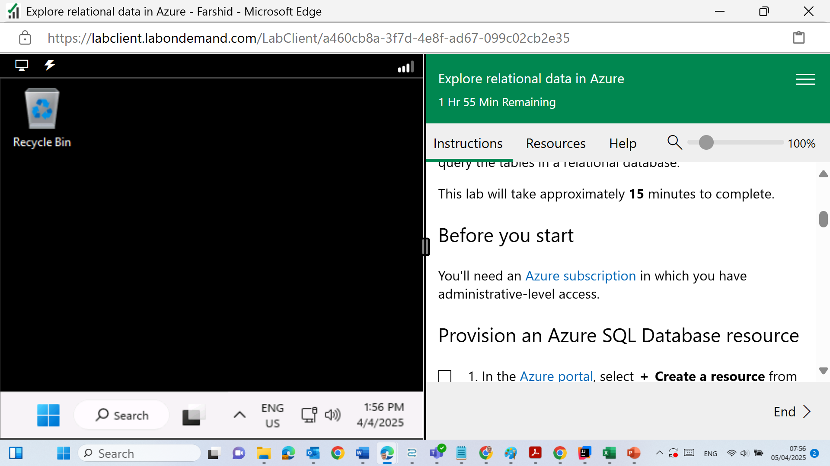
You will see this
https://portal.azure.com
2 | Faculty of Business and Law | Peter Faber Business School

Slide 34
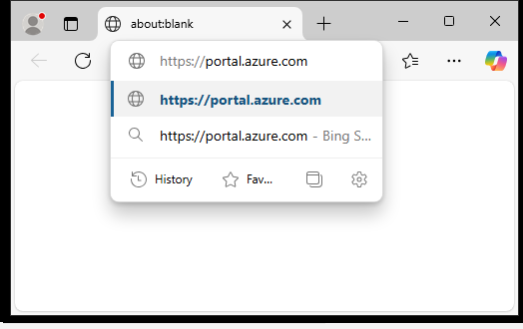
You will see this
https://portal.azure.com
2 | Faculty of Business and Law | Peter Faber Business School

Slide 35
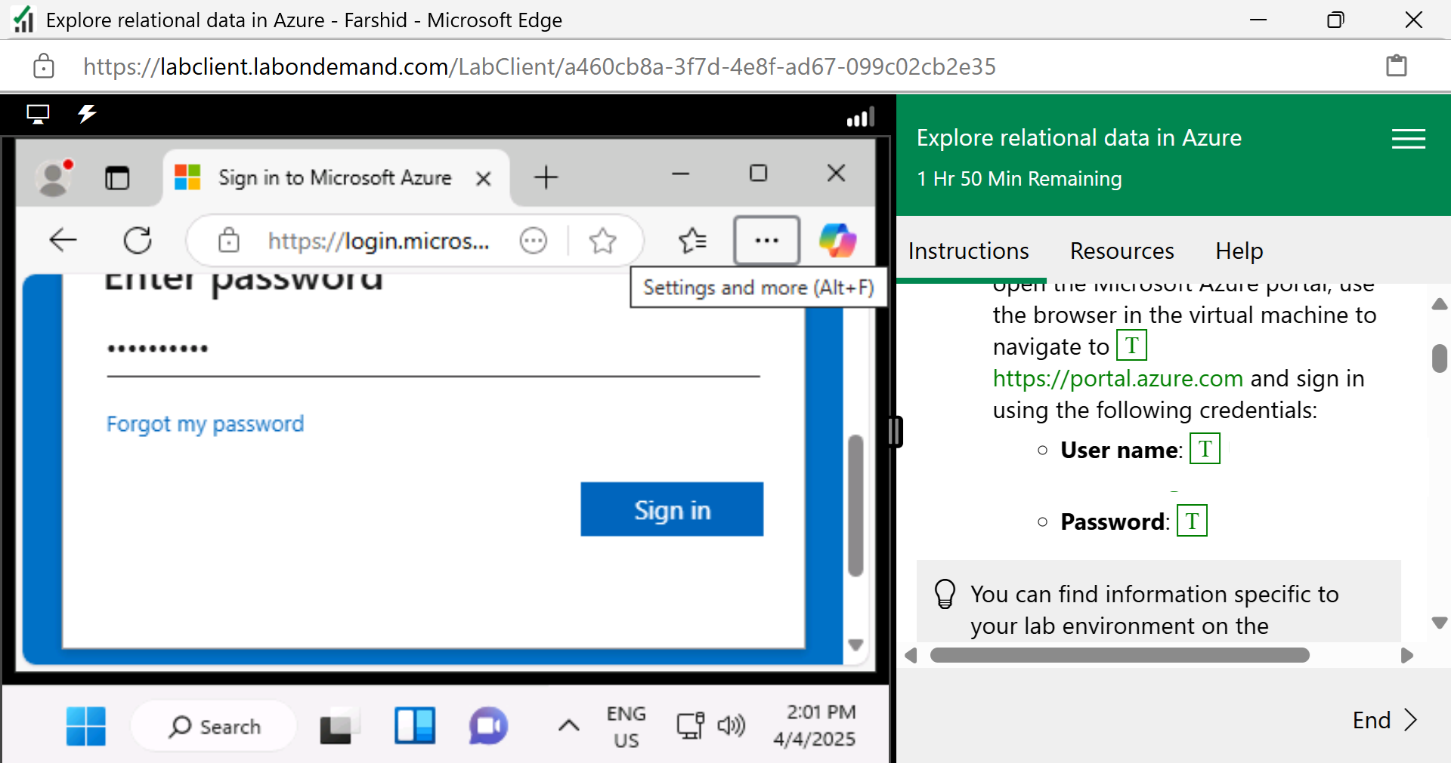
You will see this
Use the username & password provided in the instructions. Click on T
Click on Sign in
2 | Faculty of Business and Law | Peter Faber Business School

Slide 36
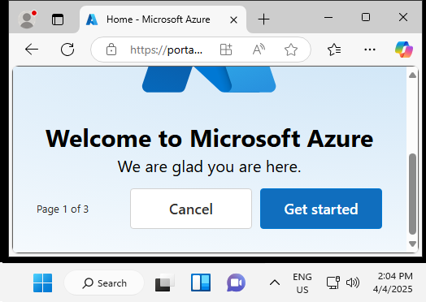
You will see this
Get Started & Select AI or Click Skip (Optional)
2 | Faculty of Business and Law | Peter Faber Business School

Slide 37
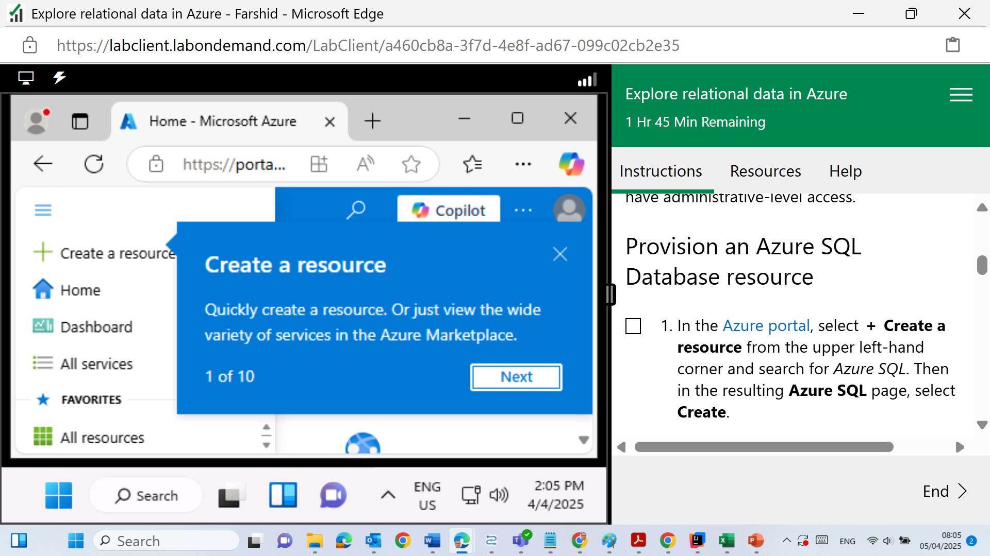
You will see this
Create a Resource
2 | Faculty of Business and Law | Peter Faber Business School

Slide 38
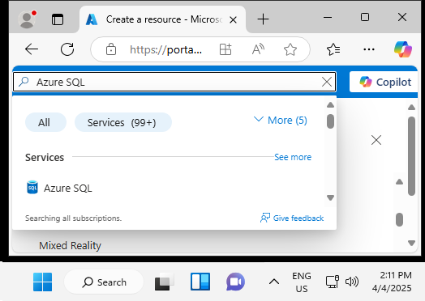
Then in the search bar, we should type "Azure SQL" – Click on it; this will take us to a page where we can see different Azure SQL options.
2 | Faculty of Business and Law | Peter Faber Business School

Slide 39
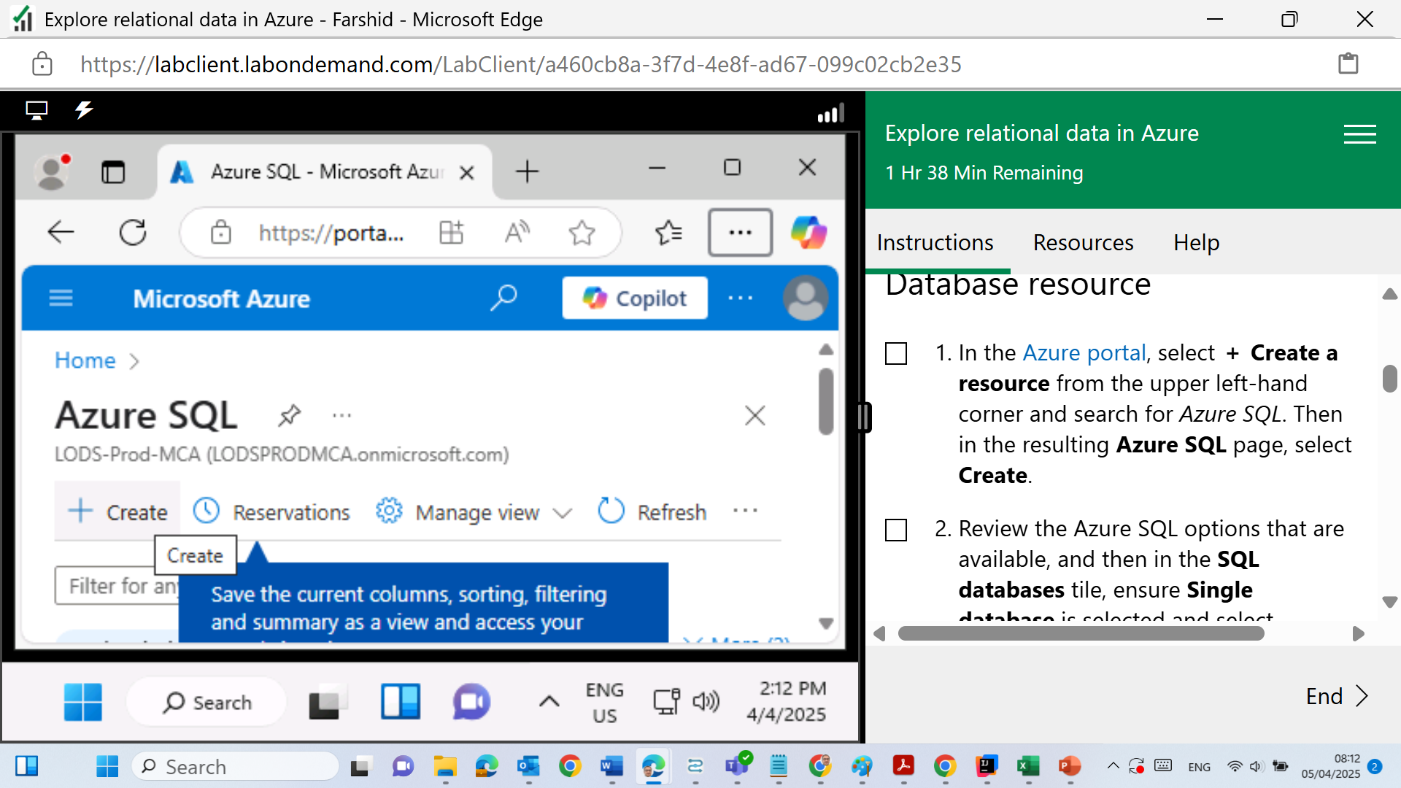
Select Create
2 | Faculty of Business and Law | Peter Faber Business School

Slide 40
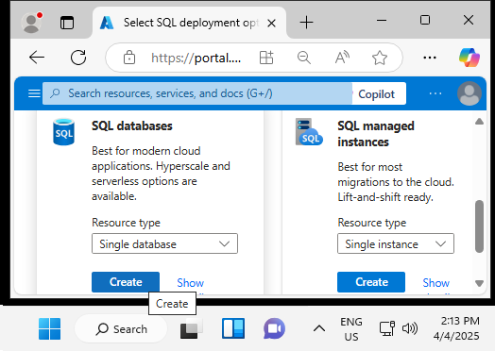
In the SQL databases tile, ensure Single database is selected and select Create.
2 | Faculty of Business and Law | Peter Faber Business School

Slide 41
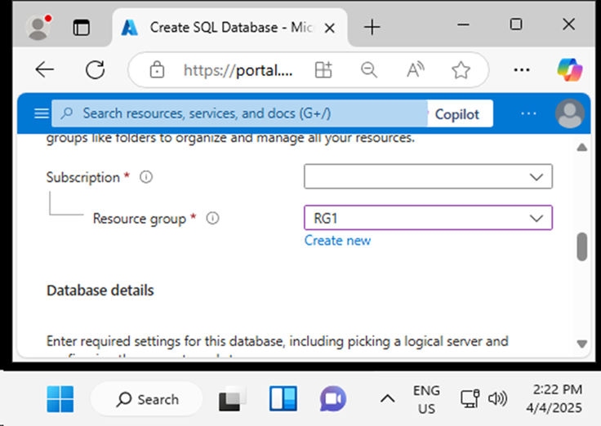
Subscription: Select your Azure subscription.
Resource group: RG1
2 | Faculty of Business and Law | Peter Faber Business School

Slide 42
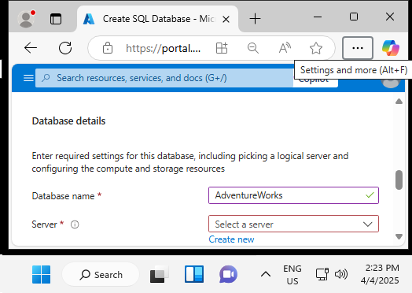
Database name as unstructured on the right side of menu
Server: Create New
2 | Faculty of Business and Law | Peter Faber Business School

Slide 43
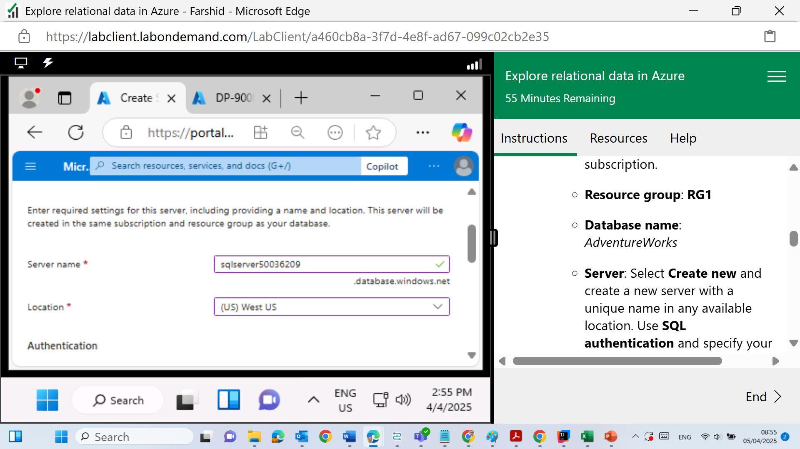
The lab specifically instructs students to use a predefined server name, like:
sqlserver50036209
2 | Faculty of Business and Law | Peter Faber Business School

Slide 44
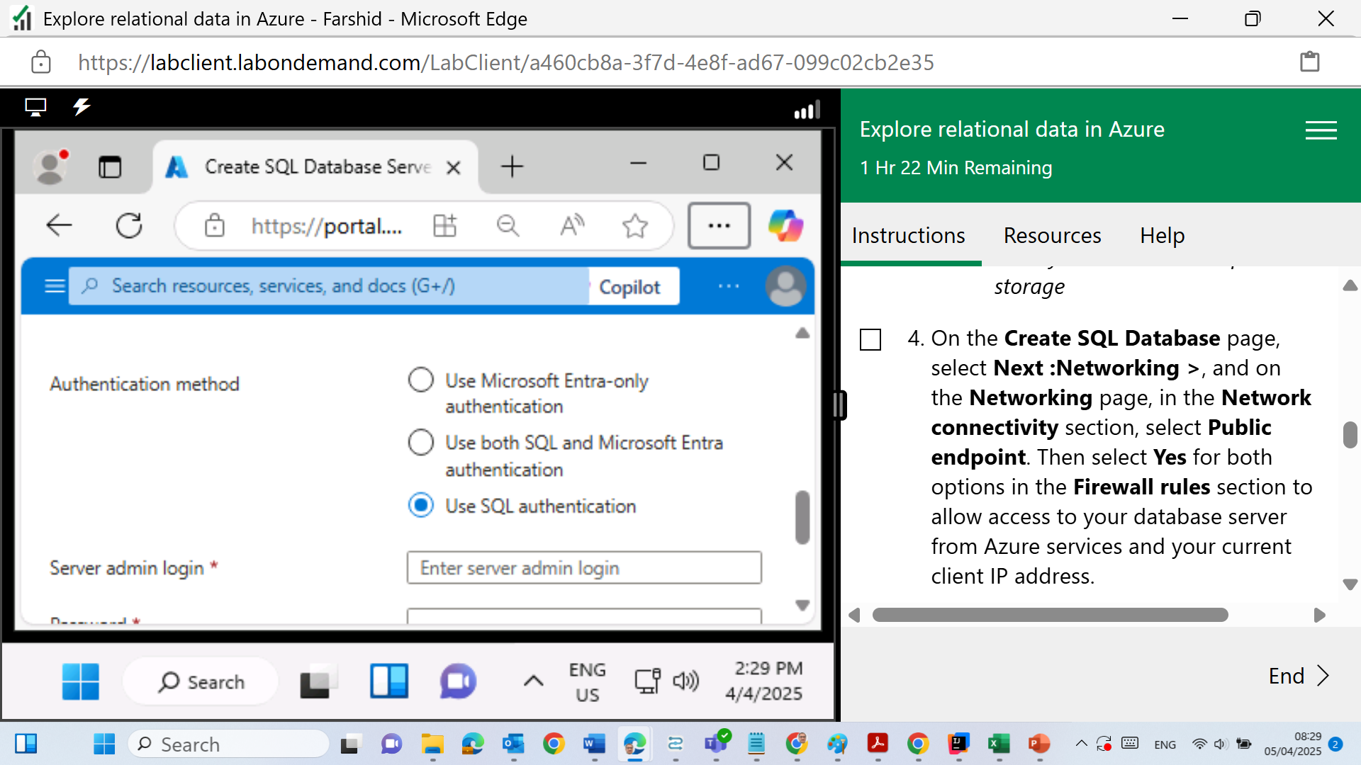
SQL Authentication
2 | Faculty of Business and Law | Peter Faber Business School

Slide 45
SQL Authentication: specify your name as the server admin login and a suitably complex password (remember the password - you'll need it later!)
2 | Faculty of Business and Law | Peter Faber Business School

Slide 46
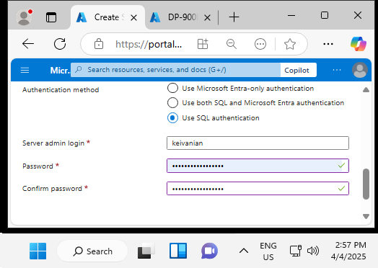
SQL Authentication: specify your surname as the server admin login and a suitably complex password (remember the password - you'll need it later!)
2 | Faculty of Business and Law | Peter Faber Business School

Slide 47
The server admin login can be your surname — that's totally fine
2 | Faculty of Business and Law | Peter Faber Business School

Slide 48
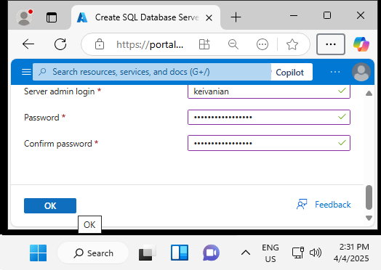
Click OK
2 | Faculty of Business and Law | Peter Faber Business School

Slide 49
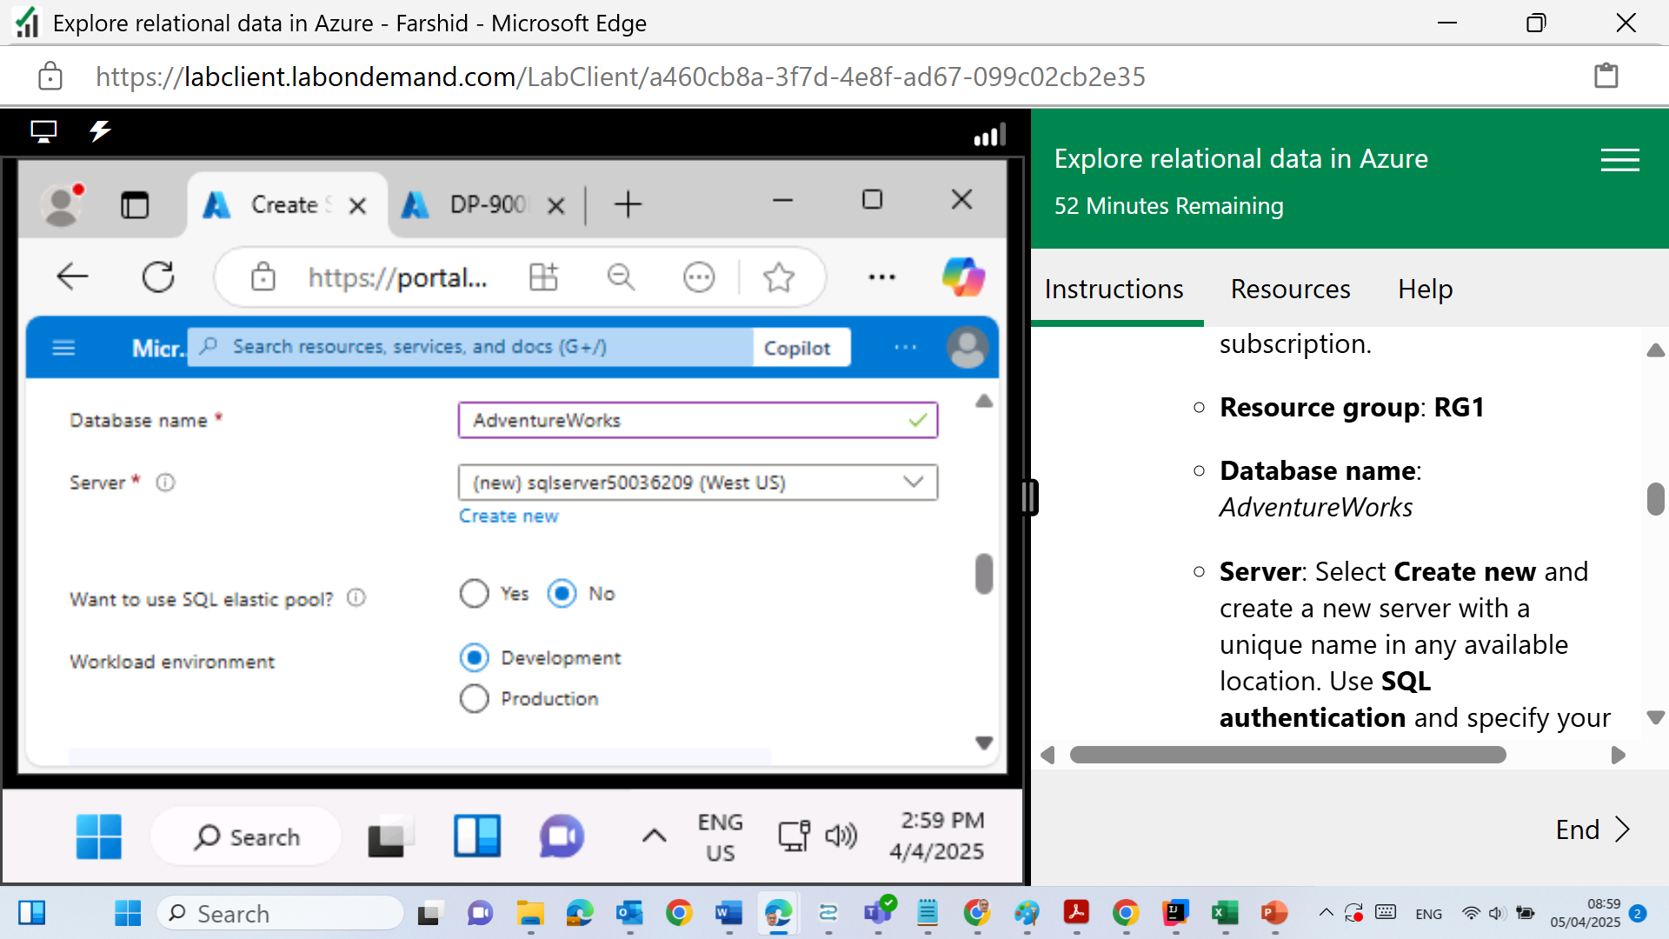
Fill the fields as below
2 | Faculty of Business and Law | Peter Faber Business School

Slide 50
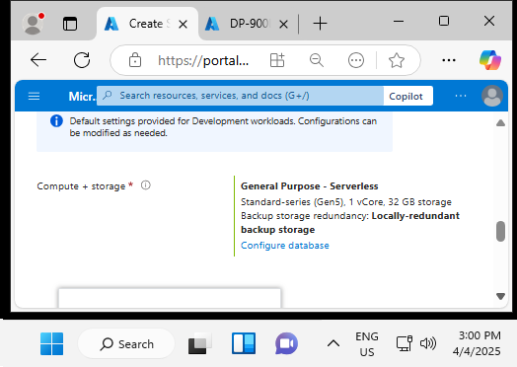
Leave unchanged
2 | Faculty of Business and Law | Peter Faber Business School

Slide 51
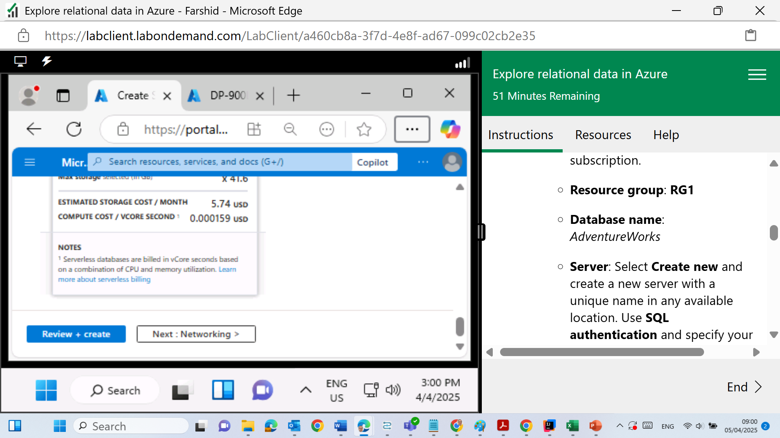
Click on Next Networking
2 | Faculty of Business and Law | Peter Faber Business School

Slide 52
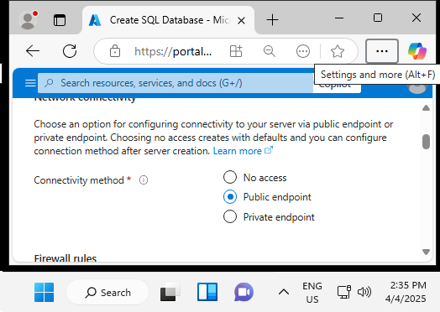
Connectivity >> Public Endpoint
2 | Faculty of Business and Law | Peter Faber Business School

Slide 53
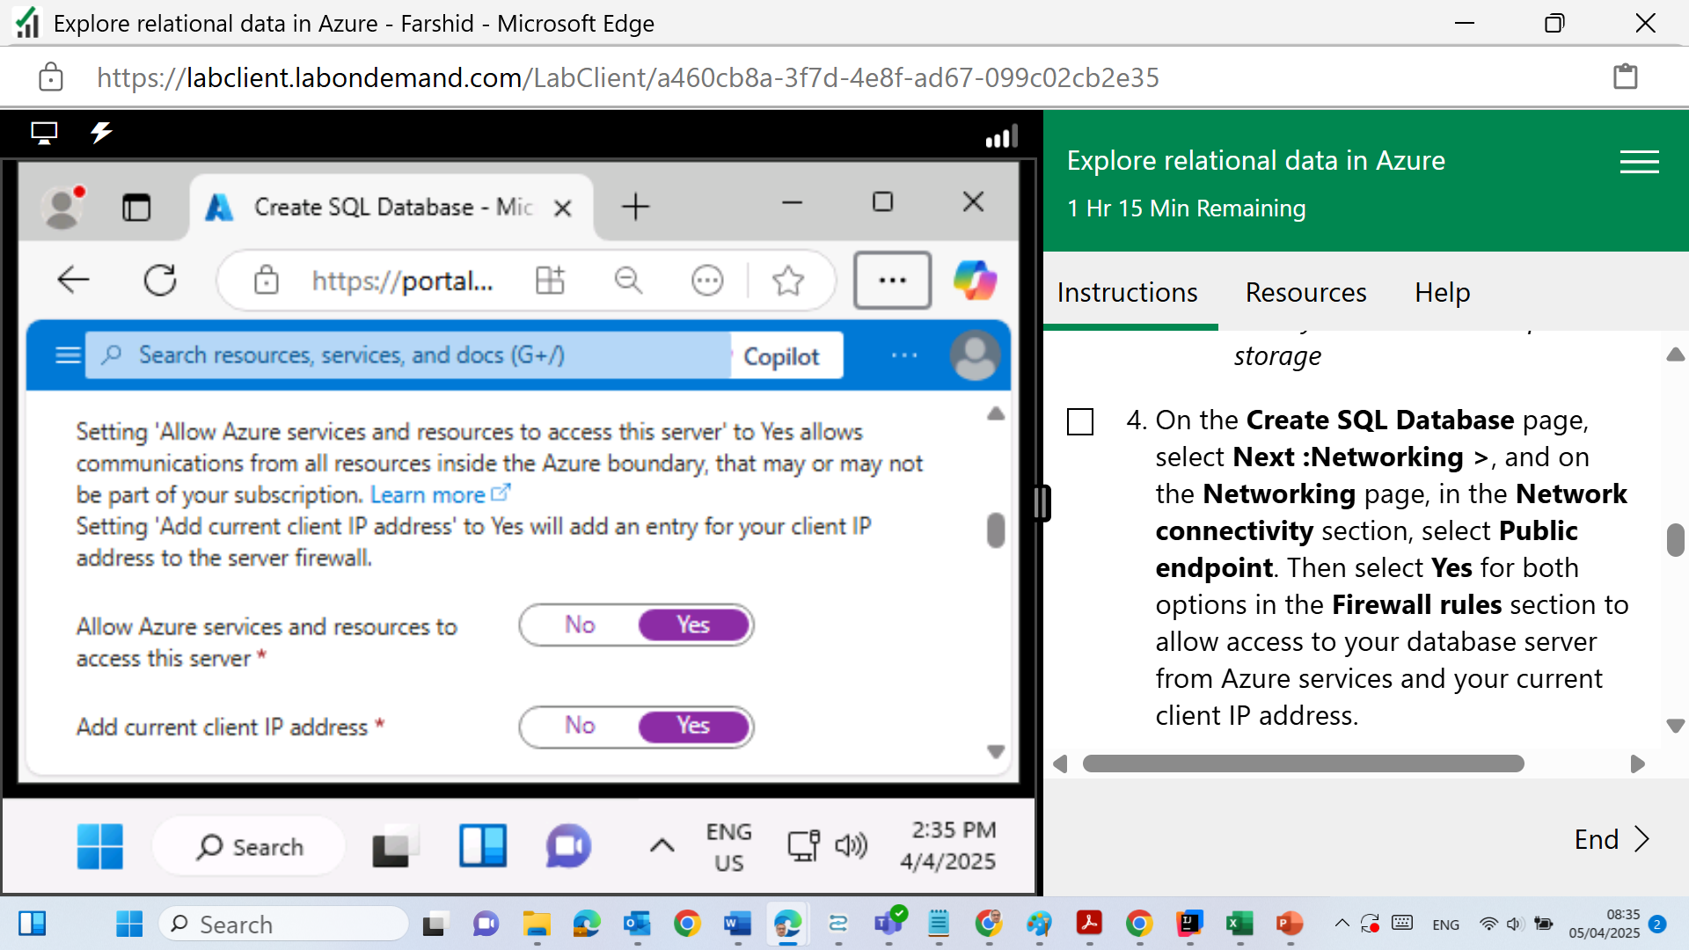
Click Yes for both Firewall rules
2 | Faculty of Business and Law | Peter Faber Business School

Slide 54
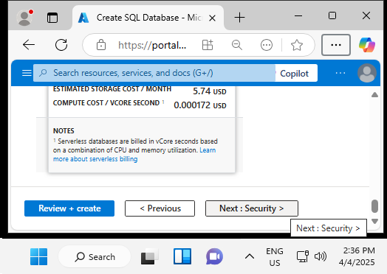
Click Next: Security
2 | Faculty of Business and Law | Peter Faber Business School

Slide 55
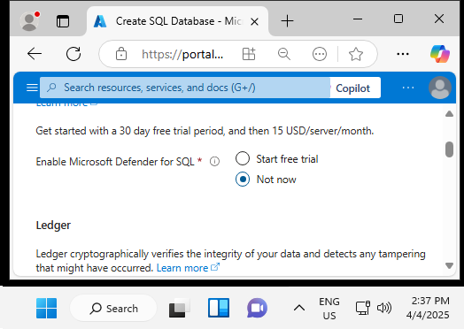
Microsoft Defender: Not Now
2 | Faculty of Business and Law | Peter Faber Business School

Slide 56
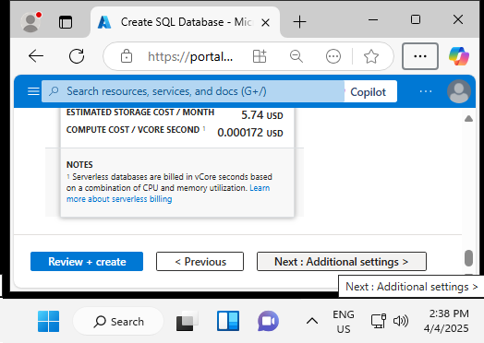
Next: Additional Settings
2 | Faculty of Business and Law | Peter Faber Business School

Slide 57
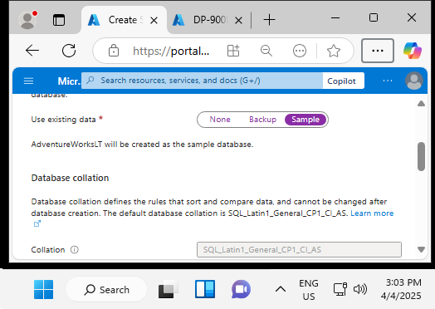
Use Existing Data: Sample
2 | Faculty of Business and Law | Peter Faber Business School

Slide 58
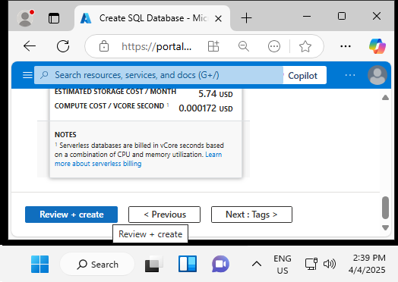
Review + Create
2 | Faculty of Business and Law | Peter Faber Business School

Slide 59
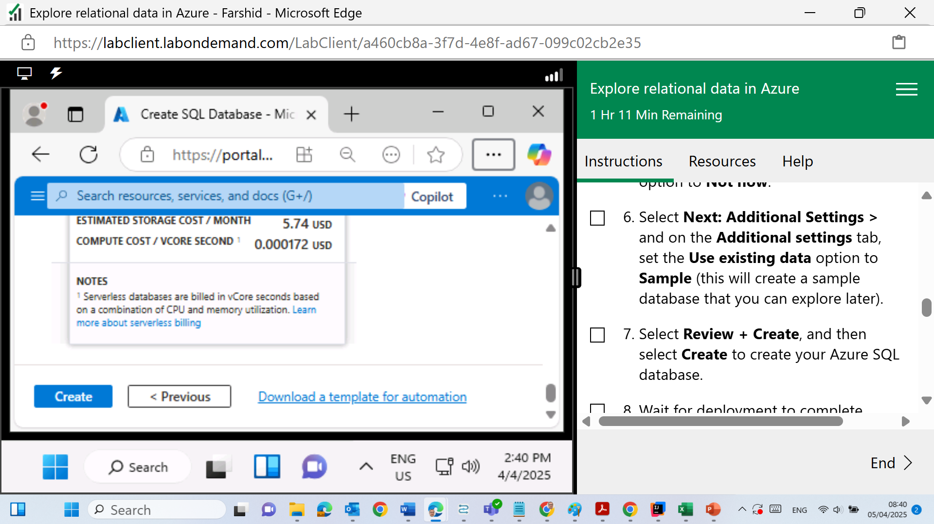
Create
2 | Faculty of Business and Law | Peter Faber Business School

Slide 60
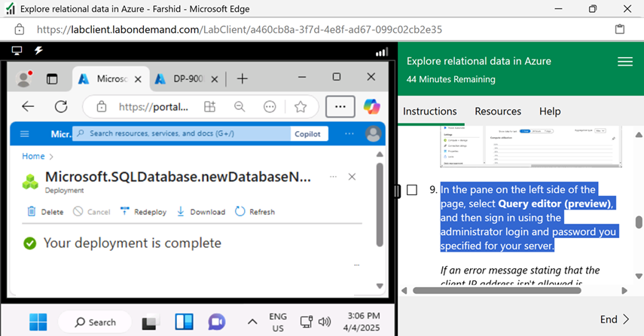
Wait for deployment to complete. Then go to the resource that was deployed, which should look like this:
2 | Faculty of Business and Law | Peter Faber Business School

Slide 61
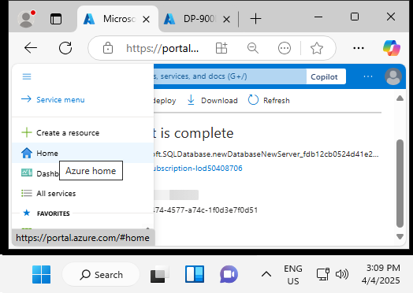
In the pane on the left side of the page, select Query editor (preview), and then sign in using the administrator login and password you specified for your server.
From the Azure portal homepage, or by clicking the portal icon or "Home", go to “SQL databases” in the left-hand menu.
Select your database (e.g., AdventureWorks).
2 | Faculty of Business and Law | Peter Faber Business School

Slide 62
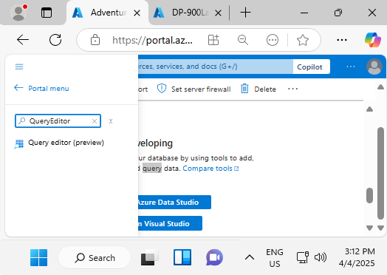
Click on AdventureWorks
Search for Query Editor
2 | Faculty of Business and Law | Peter Faber Business School

Slide 63
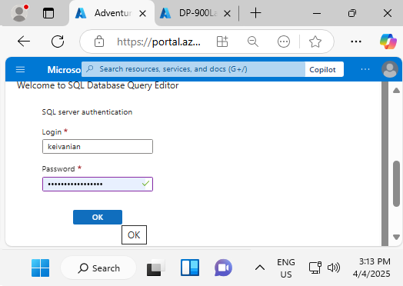
Sign in using administrative login
2 | Faculty of Business and Law | Peter Faber Business School

Slide 64
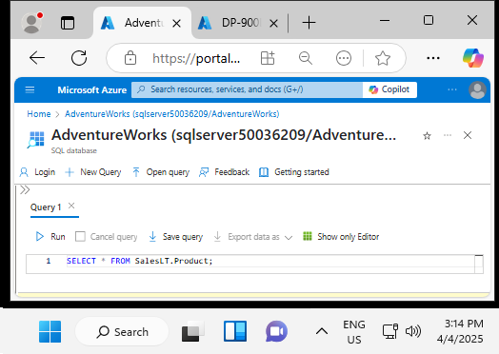
Write this SQL Query
SELECT * FROM SalesLT.Product;
2 | Faculty of Business and Law | Peter Faber Business School

Slide 65
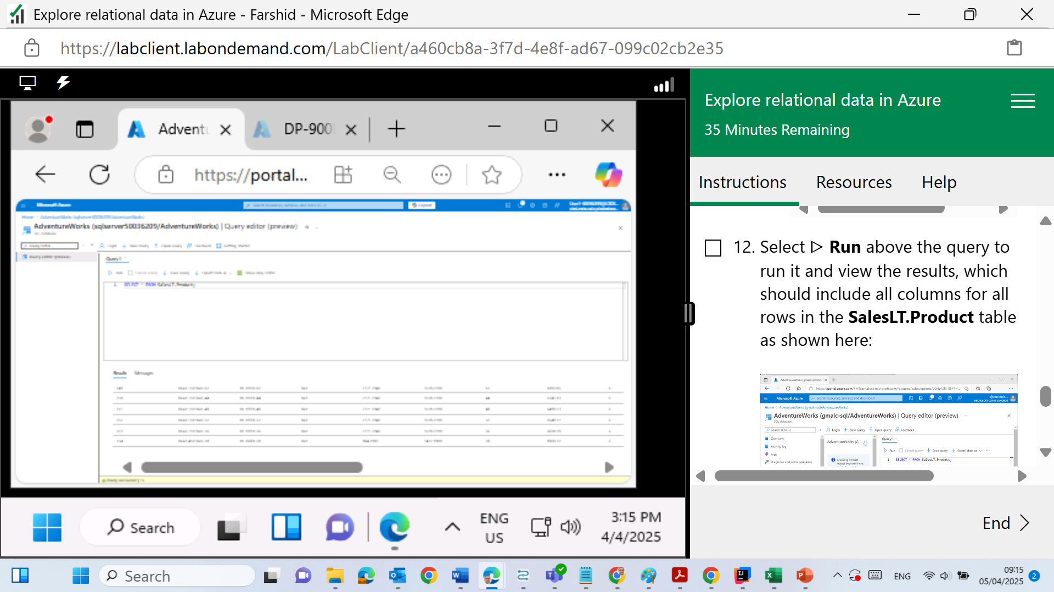
Run
2 | Faculty of Business and Law | Peter Faber Business School

Slide 66
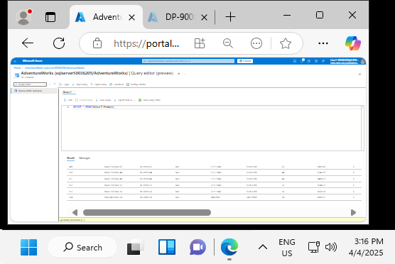
2 | Faculty of Business and Law | Peter Faber Business School

Slide 67
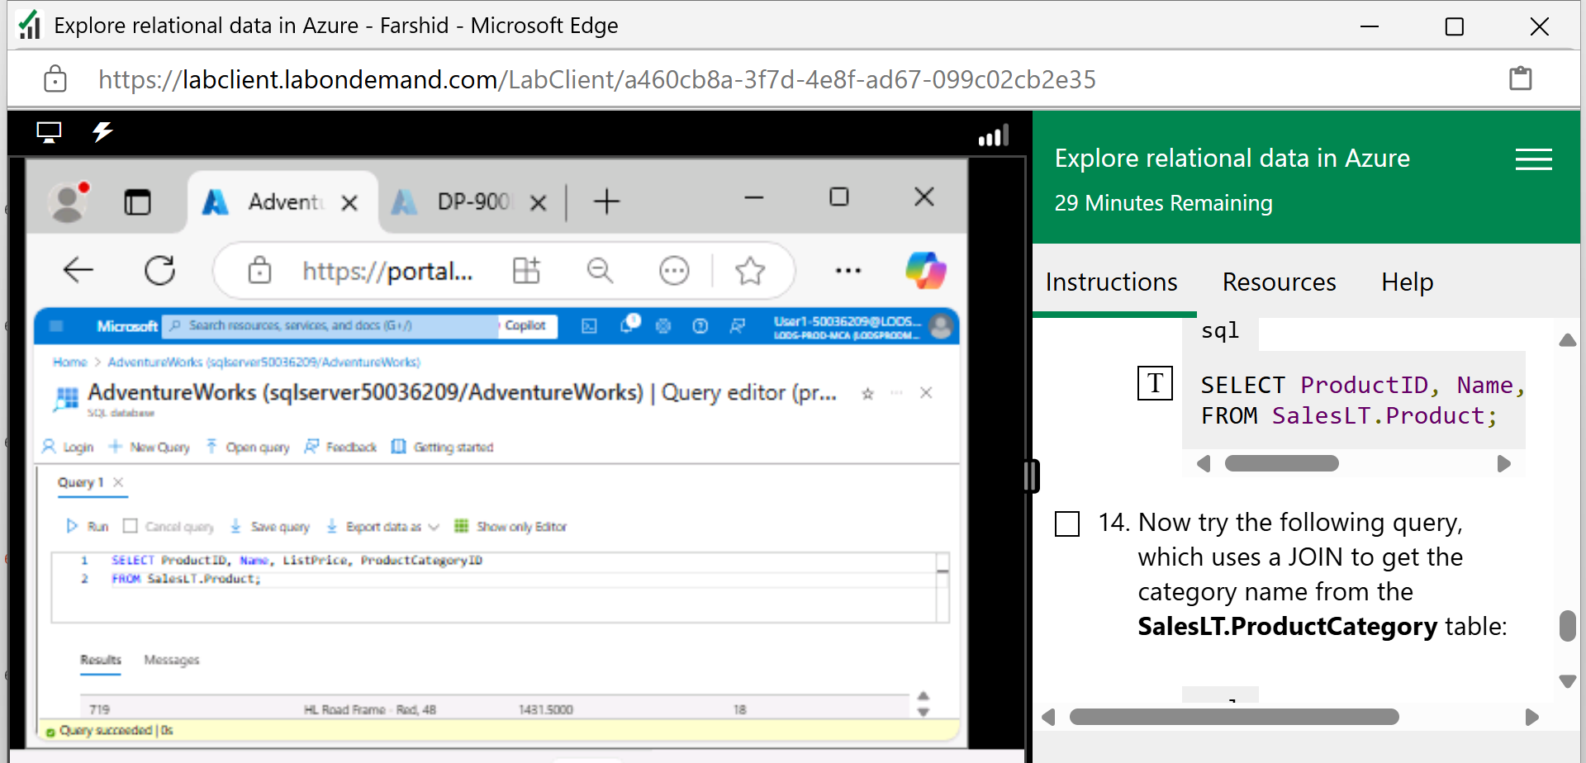
Run this query
SELECT ProductID, Name, ListPrice, ProductCategoryID
FROM SalesLT.Product;
which includes only the ProductID, Name, ListPrice, ProductCategoryID columns
2 | Faculty of Business and Law | Peter Faber Business School

Slide 68
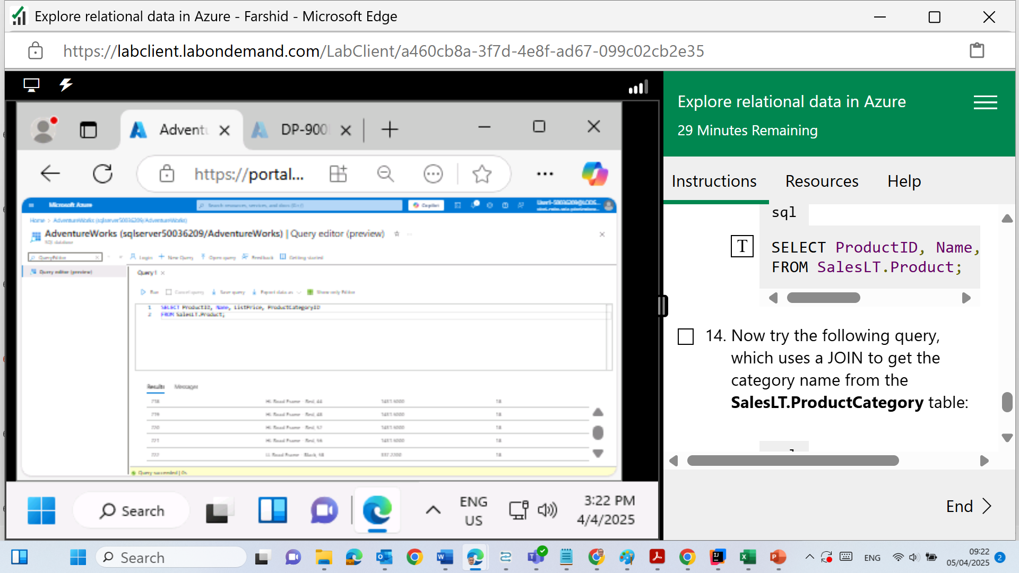
Results
2 | Faculty of Business and Law | Peter Faber Business School

Slide 69
Now try the following query, which uses a JOIN to get the category name from the SalesLT.ProductCategory table:
Click on T
SELECT p.ProductID, p.Name AS ProductName,
c.Name AS Category, p.ListPrice
FROM SalesLT.Product AS p
JOIN [SalesLT].[ProductCategory] AS c
ON p.ProductCategoryID = c.ProductCategoryID;
2 | Faculty of Business and Law | Peter Faber Business School

Slide 70
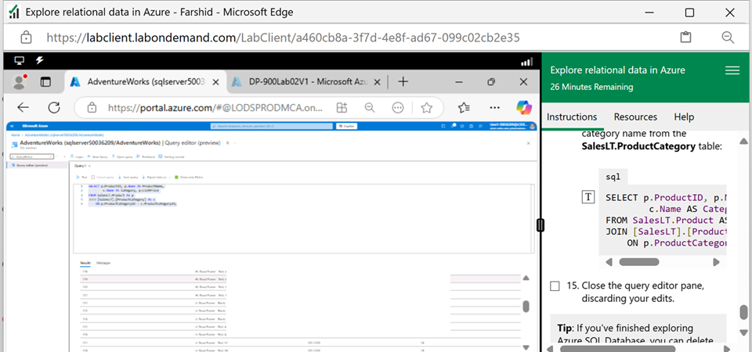
Run to see the results
2 | Faculty of Business and Law | Peter Faber Business School

Slide 71
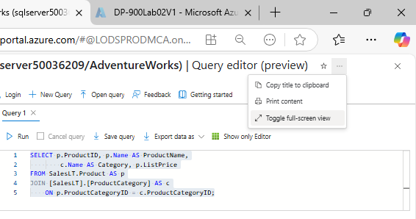
Zoom to read the results
Toggle full-screen view
2 | Faculty of Business and Law | Peter Faber Business School

Slide 72

Zoom to read the results
Toggle full-screen view
2 | Faculty of Business and Law | Peter Faber Business School

Slide 73

Close the query editor pane, discarding your edits.
2 | Faculty of Business and Law | Peter Faber Business School

Slide 74

Close the query editor pane, discarding your edits.
2 | Faculty of Business and Law | Peter Faber Business School

Slide 75
Sign out and Close the browser
Once we have completed all the steps and verified that our queries executed successfully, the final steps are:
Sign out from the Azure portal — as shown in the top-right corner in your screenshot.
Close the browser/lab window to properly end your session.
2 | Faculty of Business and Law | Peter Faber Business School

Slide 76

Click on End
2 | Faculty of Business and Law | Peter Faber Business School

Slide 77
Sign out and Close the Browser
Don’t forget to submit your screenshots (e.g., from the SQL database creation and query results) in the required Word document as instructed.
2 | Faculty of Business and Law | Peter Faber Business School

Slide 78
What to Do (Documentation)
Look at the step numbers shown on the right-hand side menu during the lab.
When you reach the following steps:
Step 8
Step 13
Step 14
Take a screenshot for each of these steps.
Paste them into a Word document.
Upload your Word file on Canvas as instructed.
2 | Faculty of Business and Law | Peter Faber Business School

Slide 79
What to Avoid (Common Mistakes)
X Don’t register with the training key more than once — this can block seats for others.
X Don’t close your browser during the lab — it will reset your session and you’ll lose progress.
X Don’t skip the firewall setup — without it, you won’t be able to access the database.
2 | Faculty of Business and Law | Peter Faber Business School

Slide 80
Summary of Learning Outcomes
After completing this lab, students will:
Understand the provisioning process of Azure relational databases
Appreciate the scalability and flexibility of cloud-based SQL databases
Gain confidence in navigating the Azure portal for database tasks
Understand how to implement basic relational design principles using Azure SQL
2 | Faculty of Business and Law | Peter Faber Business School

Slide 81
Submission of Labs & Assessments
These guidelines are designed to support your learning and help you apply necessary techniques effectively. For lab or assessment submissions, please follow instructions and complete tasks based on Canvas. If you have any questions, feel free to ask—I’m happy to help!

Slide 82
Thank You
Have a Great Learning Day!
Feel free to reach out with any questions!
Dr. Farshid Keivanian

